Slide 1
F Ⅲ W :
Fetch What We Want
BY GROUP5
Notes:
Hello everybody, we are group 5. And today I want to introduce our project to you.

Slide 2
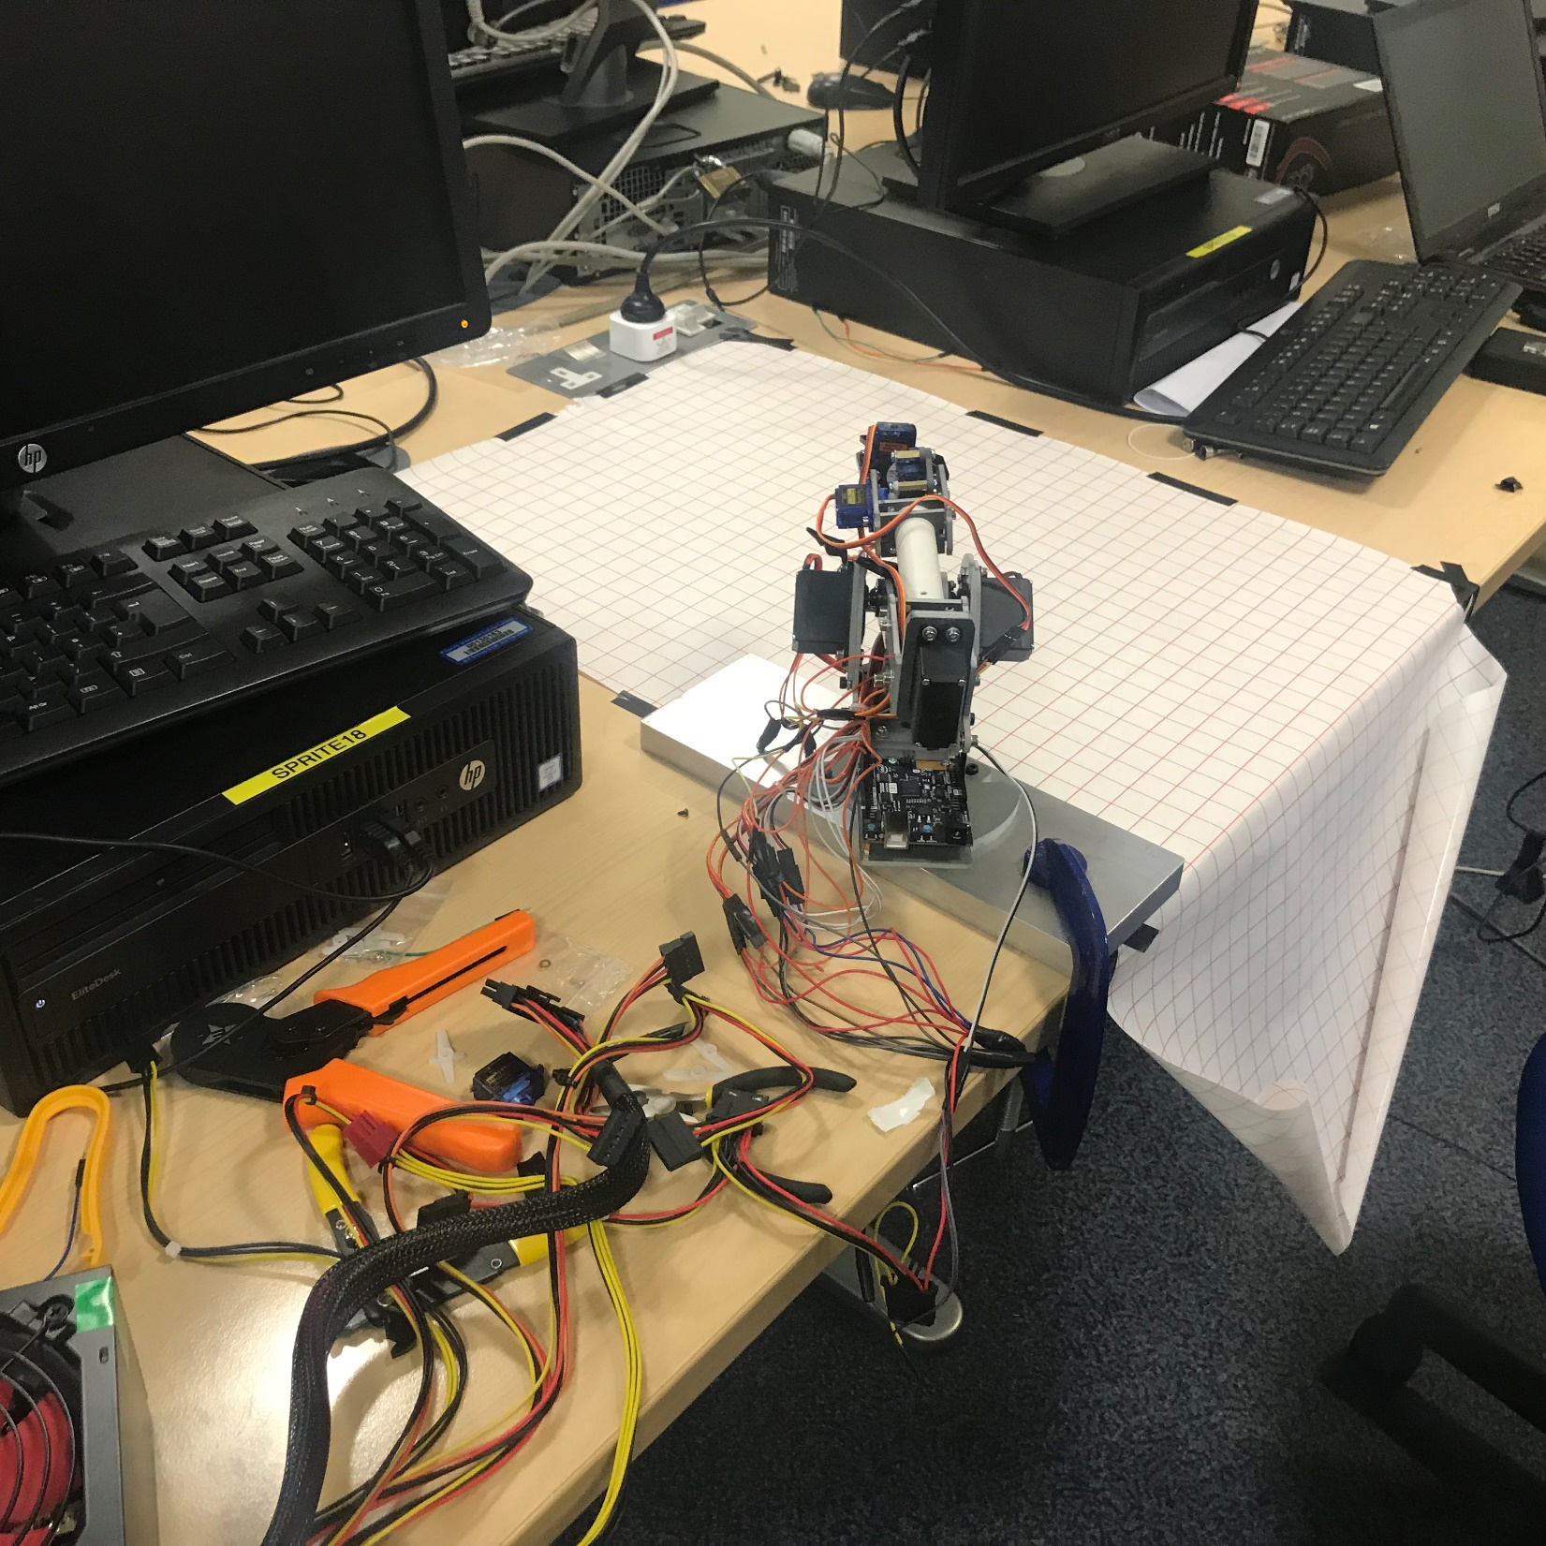
C NTENTS
01
Product Overview
02
Main Algorithm & Technology
03
Team
04
Business Model

Slide 3



Product Overview

Slide 4
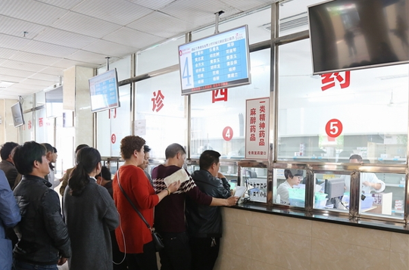
Product Overview
Existing Problems
Inaccurate
Inconvenient
1
Queuing up to get medicines is time-consuming.
2
Getting medicines manually is inconvenient and inaccurate.
Notes:
缺点，砸下来， we need to improve！！

Slide 5
Product Overview
Demand Analysis
EFFICIENT
AUTOMATED
ACCURATE
CONVENIENT
Notes:
So, the problems we are now facing require us to make the system more efficient, automated, accurate and convenient. And that’s why we came up our idea.

Slide 6
Product Overview
Demand Analysis & Our Solutions
EFFICIENT
AUTOMATED
ACCURATE
CONVENIENT
Getting medicines quickly.
No need for manual work.
Less mistakes.
Better experience.
Notes:
Our main goal is using face recognition to command robot to fetch the corresponding drugs for patients. It may works two different ways. The first, Doctors or nurses use their face ID entering the system to start it, and the patient once get their medicine list from doctors, they can come to the machine, scan their face, pay the bill by themselves. The robots we produce will find the drugs automatically and bring them to patients efficiently.
These two process can be done at the same time so as soon as the patients pay their bills, they can get their drugs immediately. And the second, aims to patients in the hospital. For example, the patients need to use medicine everyday, when it comes to drug time, patients just need to scan their face, the robot will fetch the correct drug for them accurately. It would be convenient both to hospital and patients.

Slide 7

Product Overview
Work Log
Hardware problem & solution: change the motor.
Test & improve the product.
Confirm the topic
& Distribute our work roughly.
Complete face recognition & fetching.
Business model

Slide 8
Main algorithm & technology

Slide 9
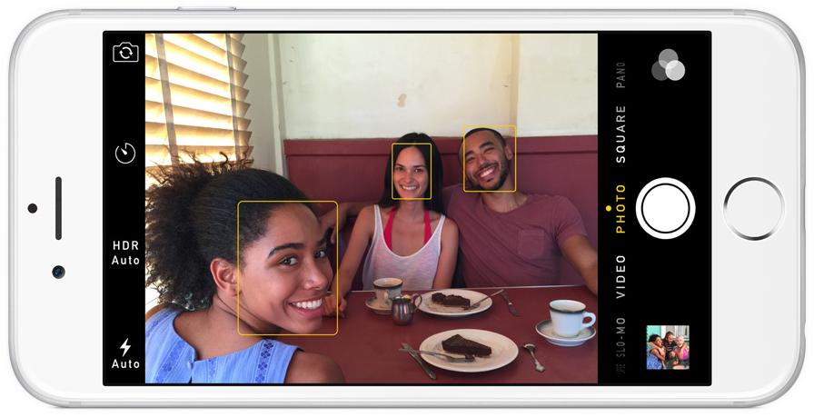
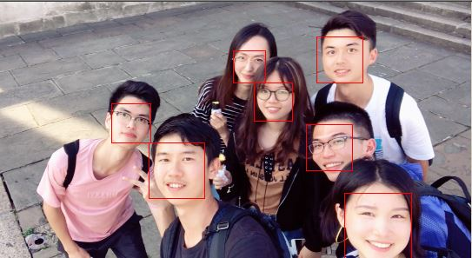
Main Algorithm & Technology
Step One: Finding all the faces(HOG)

Slide 10
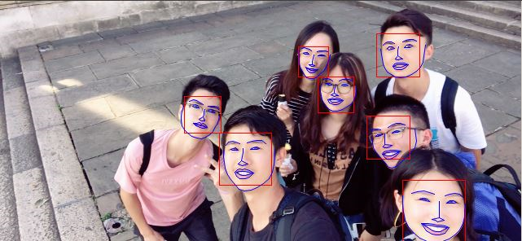
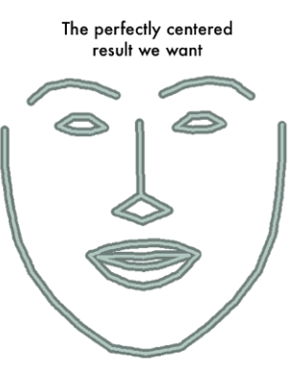


Main Algorithm & Technology
Step Two: Posing and Projecting Faces

Slide 11

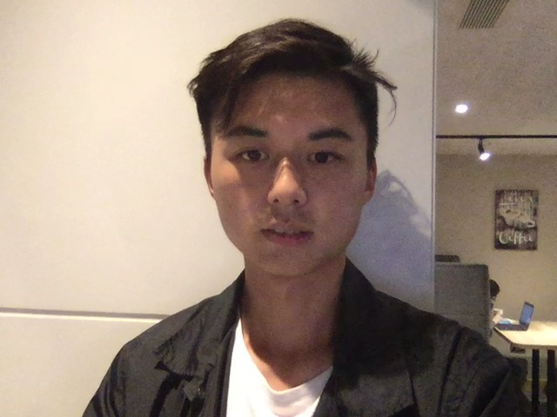
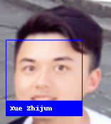

Main Algorithm & Technology
Step Three: Encoding and Comparing
Unknown Face
Known Face
Unknown Face

Slide 12
Main Algorithm & Technology
Real-time-detecting
Accurate
Flexible
Fast
Key factors
Object detection
CNN framework
yolo

Slide 13
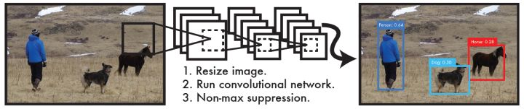
Main Algorithm & Technology
Why yolo : cause you only look once
Yolo pipeline
You only look once: it only requires one time CNN operation.This is a unified framework that provides end-to-end prediction, while real-time implementation is the speed of the Yolo algorithm.

Slide 14
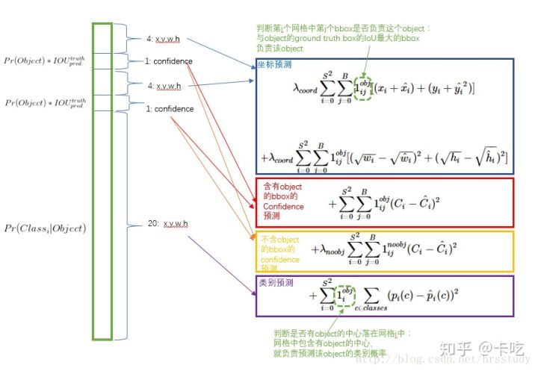
Main Algorithm & Technology
Why yolo3 : cause it is a state of art
YOLOv3 is by far the most balanced target detection network for speed and accuracy. Through the integration of a variety of advanced methods, the YOLO series of short boards (very fast, not good at detecting small objects, etc.) are all completed. Achieve amazing results and speed of grouping

Slide 15
Face recognition
Voice recognition
Main Algorithm & Technology
Fetching
Rotate repeatedly
Detects a cup
No
Slow down to recognize
Yes
grab it and deliver it

Slide 16
Main algorithm & technology
Technical Problems & Solutions
01
02
03
04
05
Hardware
Camera
Speed
QR code
Catching
Change another new motor.
Put down the camera. It works horizontal to get the location of the drug.
CPU GPU
Cutting and sharpening
Measure repeatedly
Notes:
Hardware: the motor’s gear is broken.
Solution: change another new motor.
Camera’s position
Solution: put down the camera. It works horizontal to get the location of the drug.
The speed of recognition seems too slow.
Solution: CPU to GPU
The distance between camera and the QR code is too small, and the image is fuzzy.
Solution: Cutting and sharpening.
The catching process
Solution: Measure repeatedly

Slide 17
Team

Slide 18
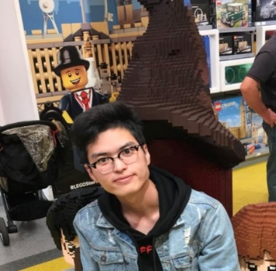
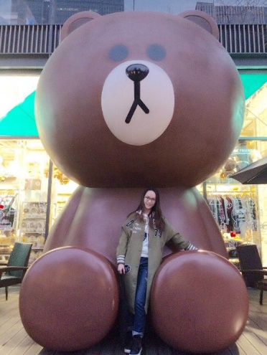
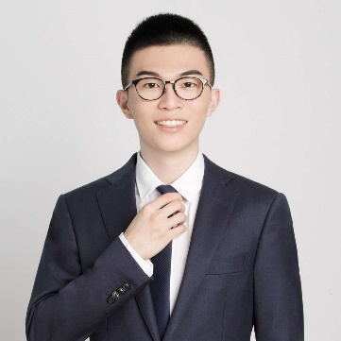


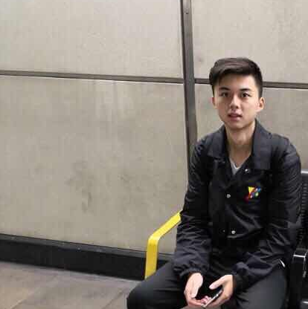
Team
Introduction
Yuzheng Yang
Yueheng Wei
Ruigang Yao
杨宇政
魏玥恒
姚睿刚
Liangboya Zhou
Chenyu Liu
Zhijun Xue
周梁博雅
刘晨雨
薛智钧

Slide 19
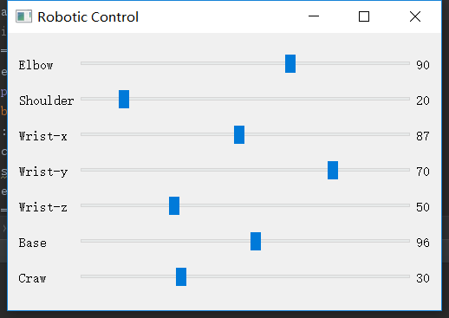
Team
Teamwork
Hardware
Software
used python to design a UI to control the robotic arm
dealing with face recognition and object detection
voice recognition and the automated motion of the arm
the final version of our product

Slide 20
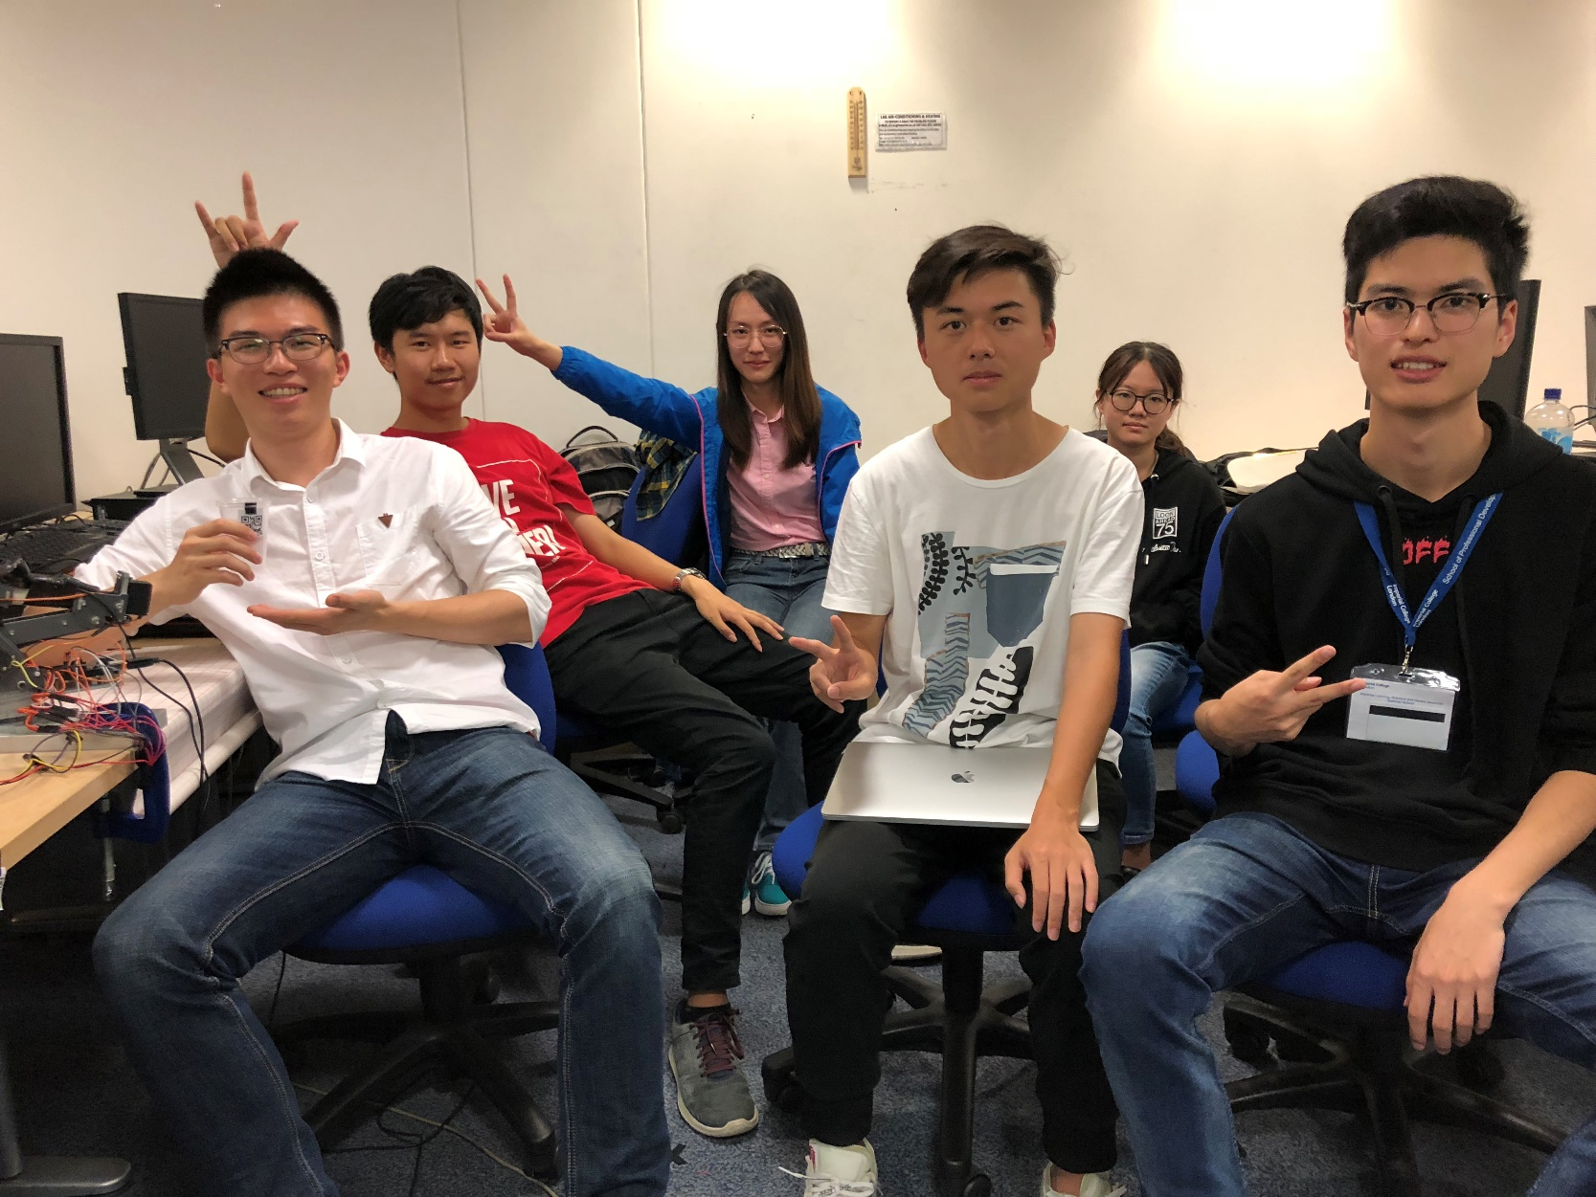
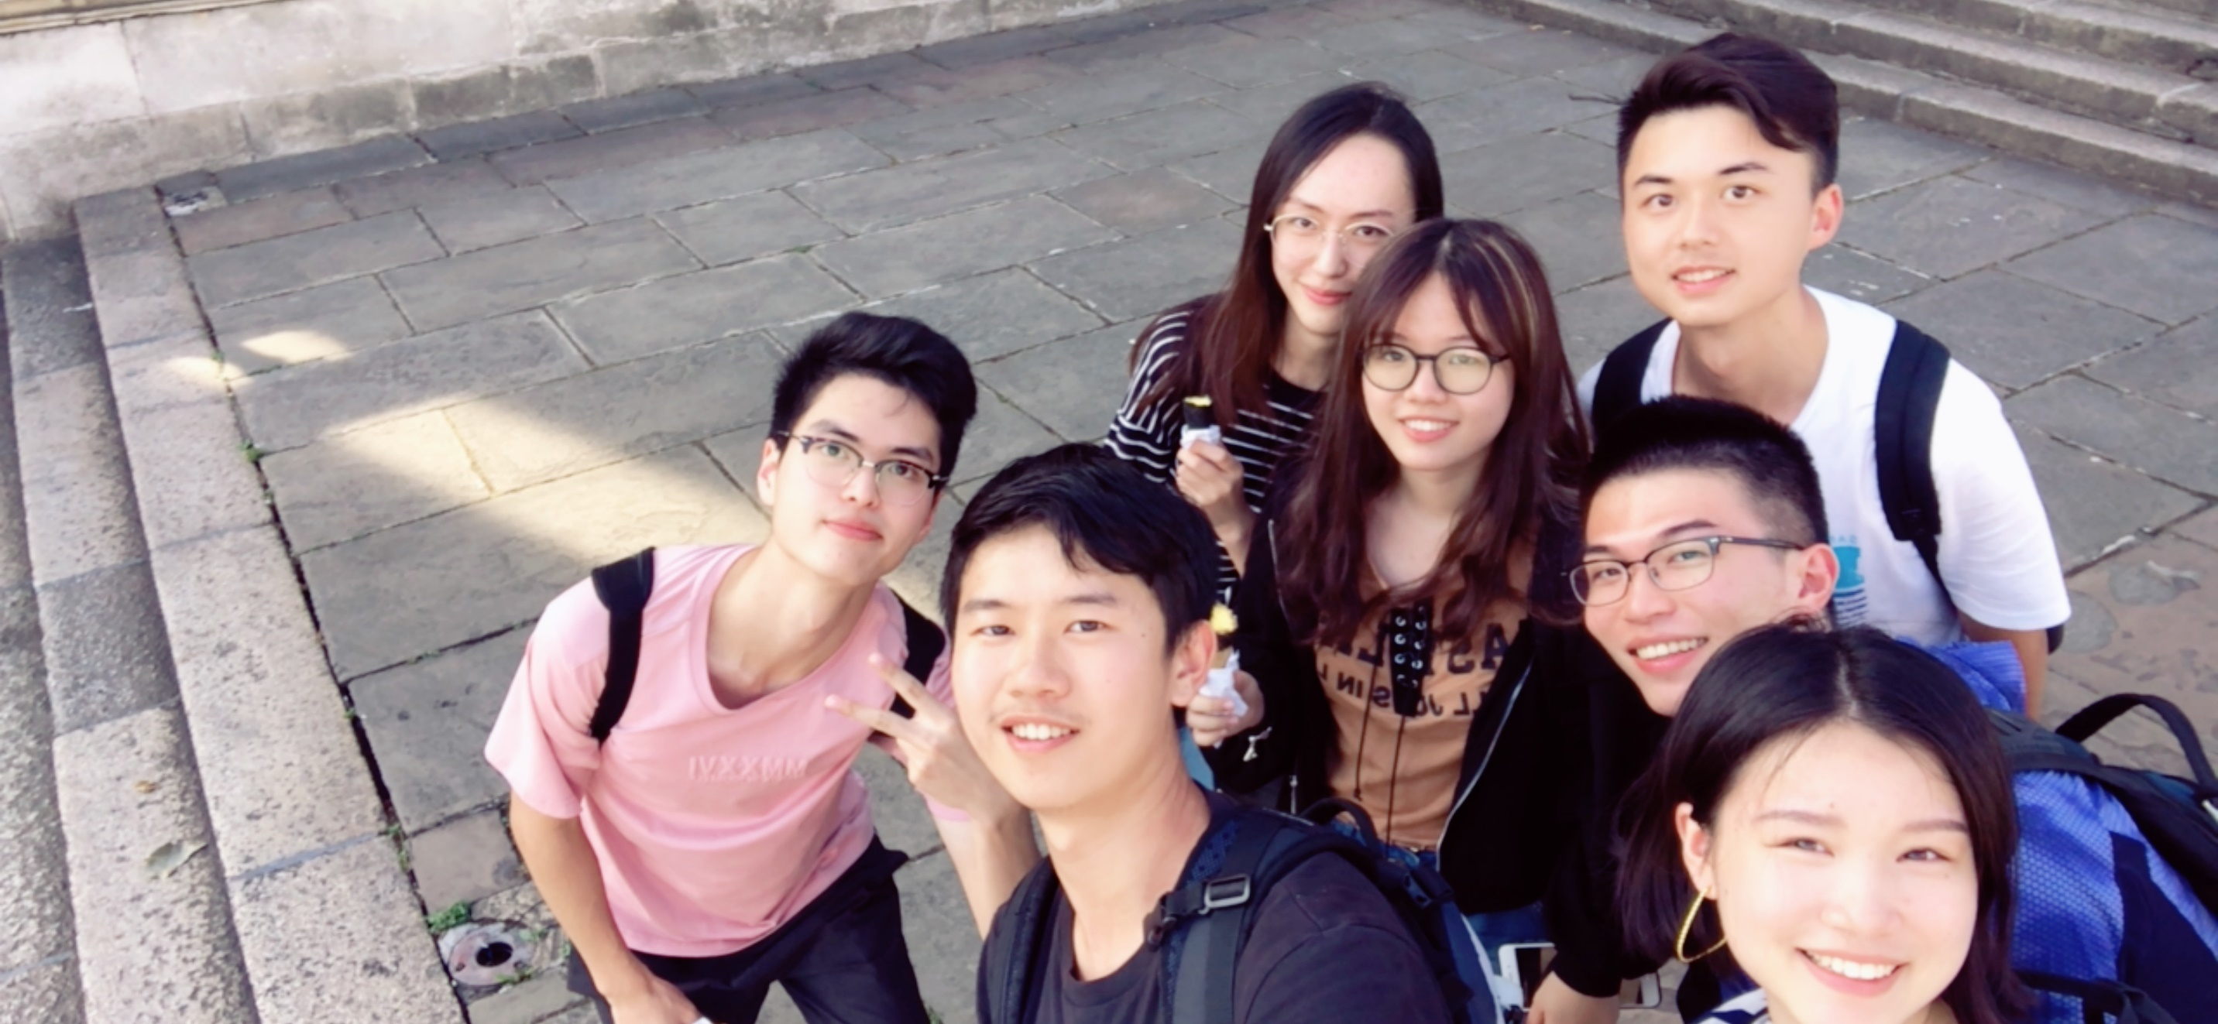
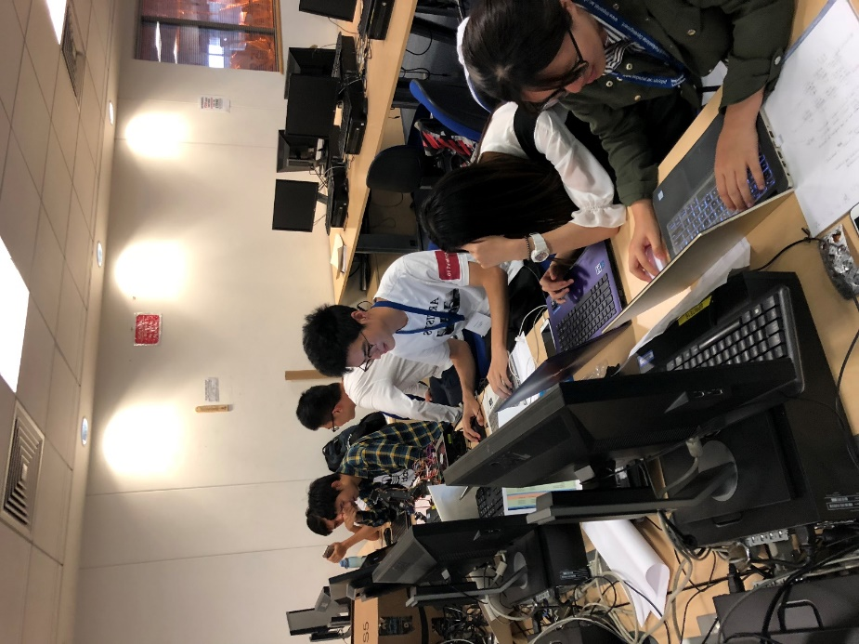
Team
Teamwork

Slide 21
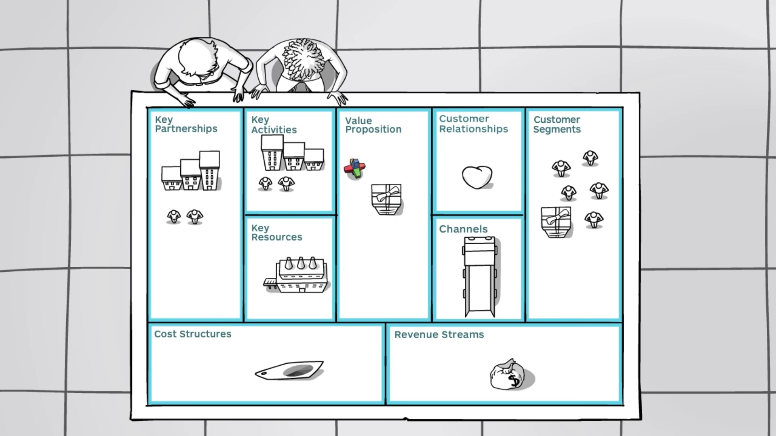
Business Model

Slide 22
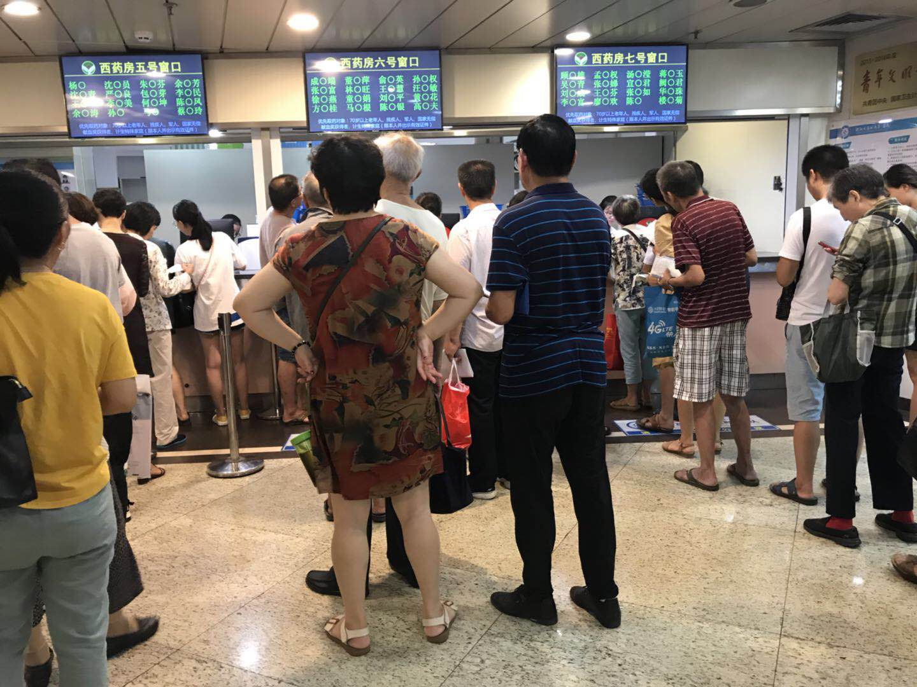
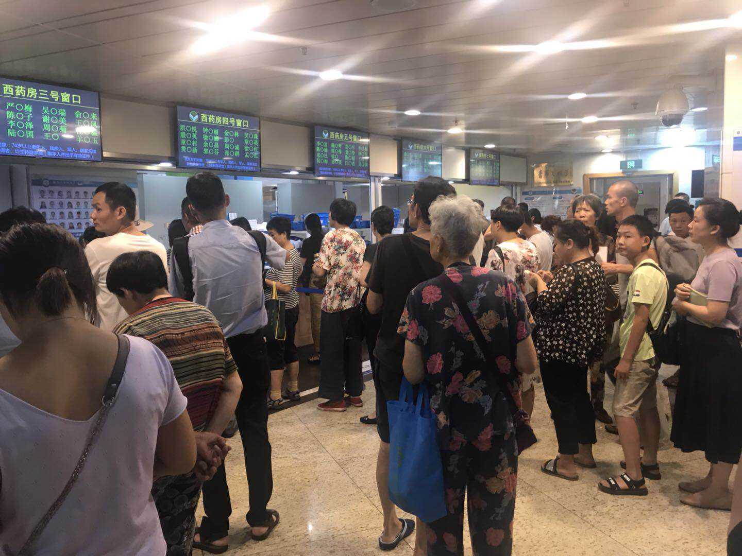
Business Model
Market analysis
20
The average of the queuing time for each patient in China is 20 minutes.
Notes:
Even some has set up different medicine pharmacy, and multiple windows, but tedious drug extraction procedures still make queuing a common phenomenon.

Slide 23


Business Model
Customer segments

Slide 24
Business Model
Process
1
Load in facial information
Enter the prescription to the system
2
3
Scan the face
Pay the bill
4
5
Robot fetching

Slide 25
Business Model
Value Proposition
Using face recognition to command robot to
fetch the corresponding drugs for patients.
A
E
ACCURACY
EFFICIENCY
C
A
CONVENIENCE
AUTOMATION

Slide 26
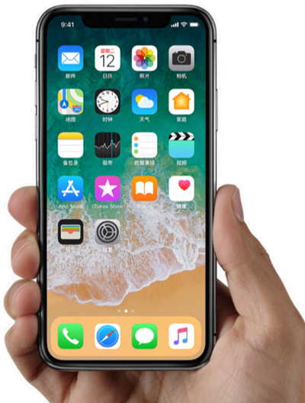
Business Model
App

Slide 27
Business Model
Key Partners
HOSPITAL
CAFETERIA
AIRPORT
LIBRARY

Slide 28
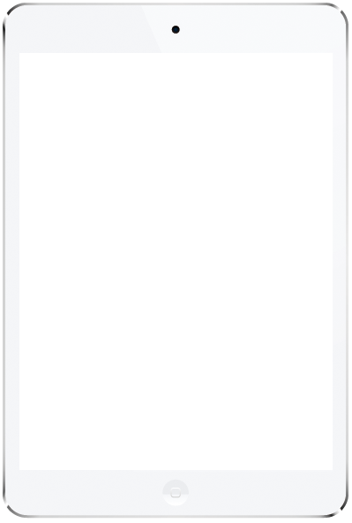


WE ARE
THE BEST TEAM

Slide 29
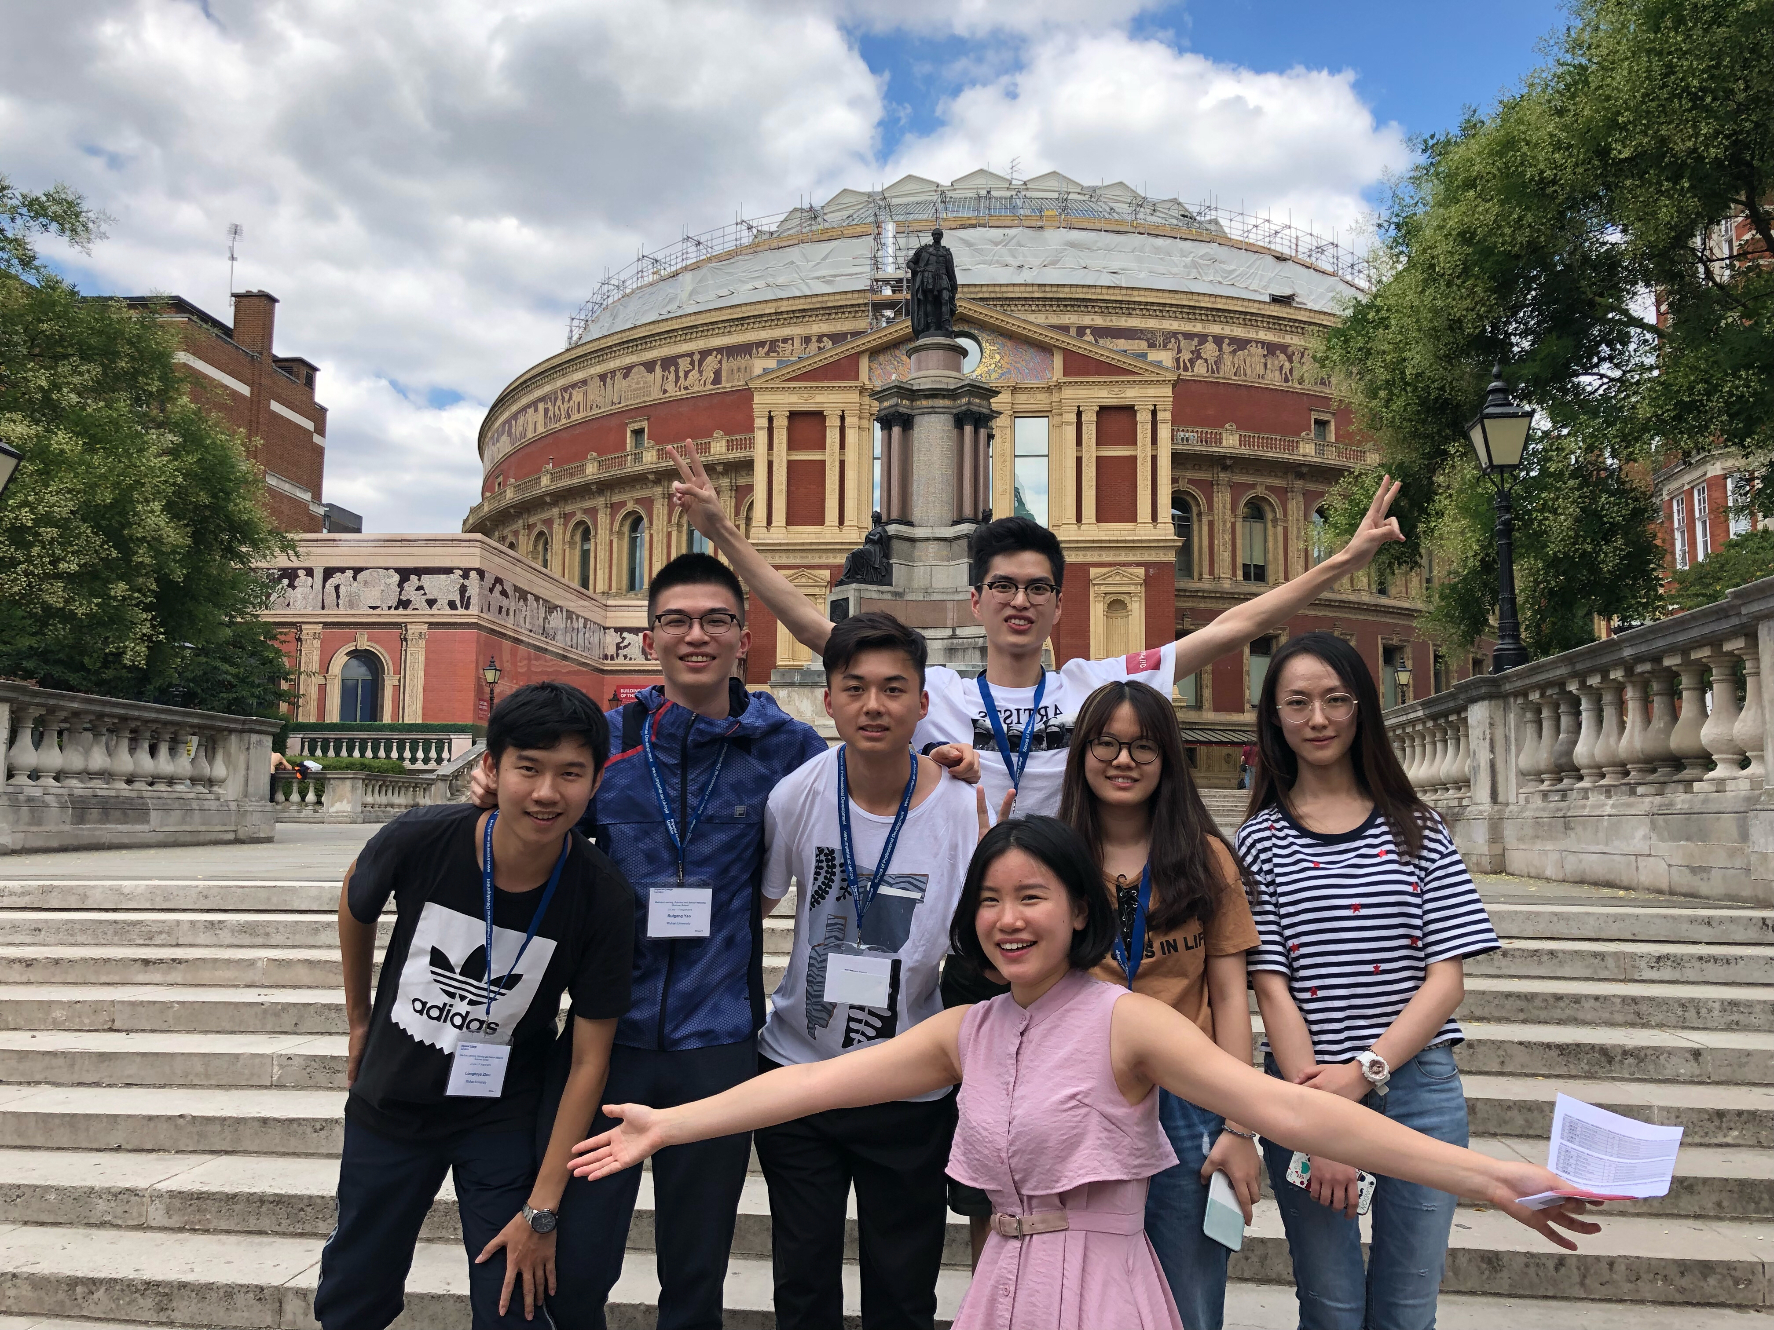

THANK YOU!
PRESENTED BY GROUP5

